Slide 1

Dawood University Department of Cyber Security Section A2 Pakistan Studies
Khilafat Movement (1919–1924)
Students
25F-CY-174 Shahmeer Raza
25F-CY-057 Azeem Iqbal
25F-CY-176 M.Sarim Khan
Teacher Name: Faisal

Slide 2
S.No | Topic | Pg.No
1 | Introduction to Khilafat Movement | 3
2 | Reason of Khilafat Movement | 4
3 | Leadership the Movement Wanted to Protect | 5
4 | Leaders Who Started the Movement | 6
5 | Activities of the Khilafat Movement | 7
6 | Important Meetings | 8
7 | Migration Movement (Hijrat Movement) | 9
8 | Non‑Cooperation Movement | 10
9 | Reasons for the Failure of the Movement | 11

Slide 3
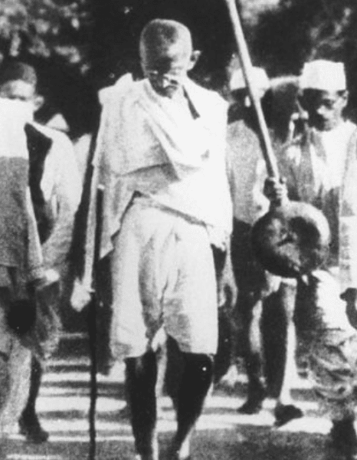
Introduction: Khilafat Movement
The Khilafat Movement was a political and religious movement launched by Indian Muslims after World War I to protect the Ottoman Caliphate. It played an important role in the history of the Muslim struggle in the Indian subcontinent.

Slide 4
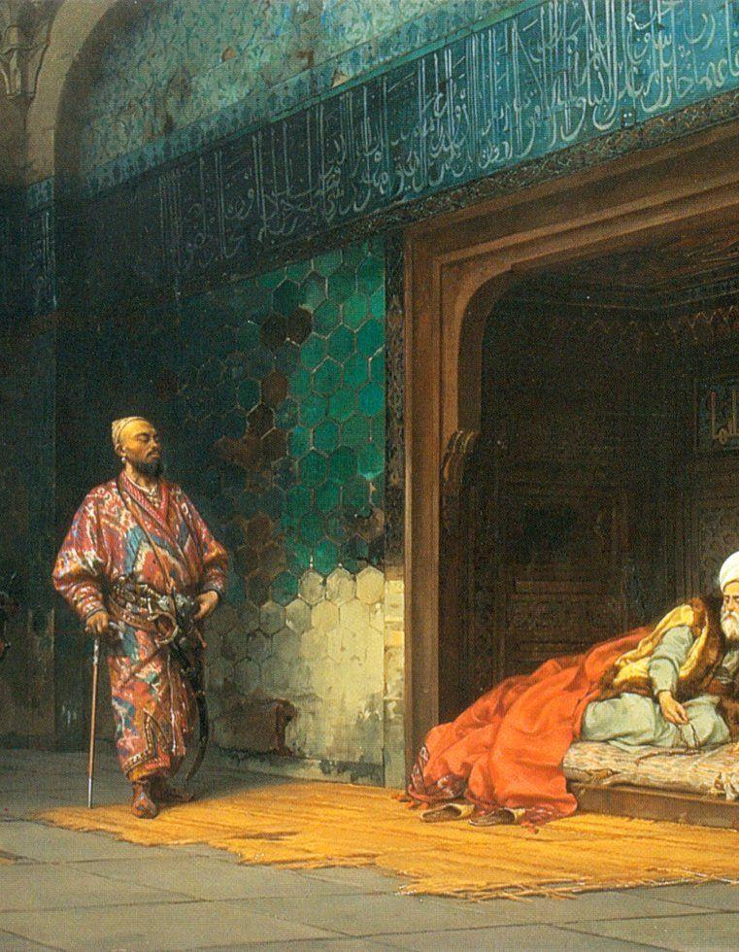
Reasons for the Start of the Movement
After World War I, the Ottoman Empire was defeated. The Allied powers planned to divide its territories and weaken the authority of the Ottoman Caliph, who was considered the leader of Muslims worldwide. Indian Muslims believed it was their religious duty to defend the Caliphate and therefore began a movement demanding that the British government protect it.

Slide 5
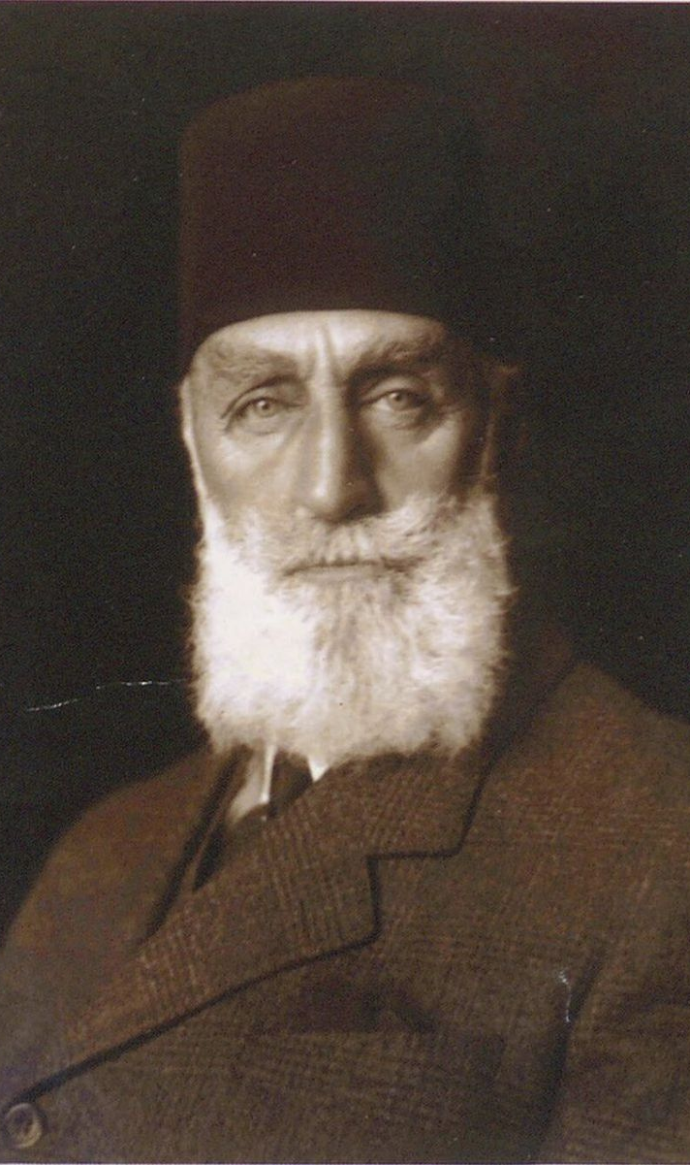
Leadership the Movement Wanted to Protect
The movement aimed to protect the leadership of the Ottoman Caliph, who was considered the spiritual and political leader of Muslims worldwide. At that time the Caliph was the Ottoman Sultan, and many Muslims believed that his authority symbolized unity in the Muslim world. If the Caliphate was abolished, Muslims feared it would weaken the political and religious unity of the Islamic world. For this reason, Muslims in India strongly supported efforts to keep the Caliph and his authority intact.

Slide 6
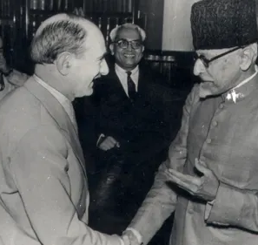
Leaders Who Started the Movement
The Khilafat Movement was started by prominent Muslim leaders in India who were concerned about the future of the Caliphate. The most important leaders were the Ali Brothers, Maulana Muhammad Ali and Maulana Shaukat Ali. Other important figures included Maulana Abul Kalam Azad, Hakim Ajmal Khan, and Dr. Mukhtar Ahmad Ansari. These leaders organized the Khilafat Committee and worked to mobilize Muslims across India to support the movement.

Slide 7
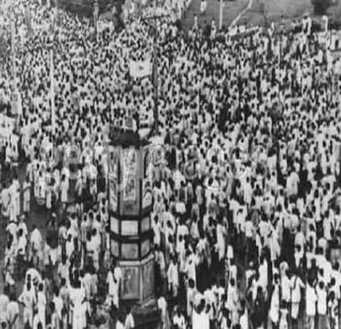
Activities of the Khilafat Movement
The leaders of the movement organized meetings, public gatherings, and conferences to raise awareness among Muslims about the importance of protecting the Caliphate. They also held protests and demonstrations against British policies and tried to unite Muslims under a common cause. Newspapers and speeches were used to spread the message of the movement. Large political meetings were held in different cities where people pledged support for the Khilafat cause.

Slide 8
Important Meetings
All-India Khilafat Conference (1919) This Meeting was held in Delhi. By Muslim leaders. Decision after this meeting was to organize a political movement to pressure the British.
Khilafat Delegation to Britain (1920) This meeting was held in London. They tried to convince the British government to protect the Caliphate.
Karachi Khilafat Conference (1921) This meeting was held in Karachi in which Muslims were urged to boycott British institutions and support the movement.

Slide 9
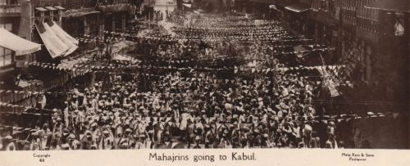
Migration Movement (Hijrat Movement)
One important activity related to the Khilafat Movement was the Hijrat Movement in 1920. Some Muslim leaders declared that living under British rule was unacceptable if it threatened Islamic leadership. As a result, thousands of Muslims migrated from India to Afghanistan believing it would be a safer place for Muslims. However, the migration caused great hardship because Afghanistan could not accommodate such a large number of migrants.

Slide 10
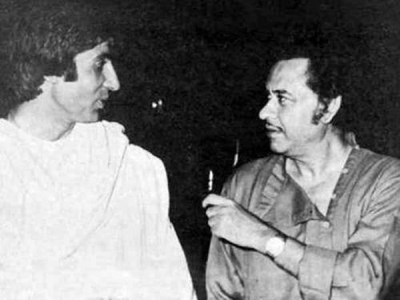
Non‑Cooperation Movement
The Khilafat leaders also joined hands with the Indian National Congress under Mahatma Gandhi to start the Non‑Cooperation Movement against British rule. People were encouraged to boycott British goods, schools, courts, and government institutions. This cooperation between Muslims and Hindus created a temporary period of political unity in India against colonial rule. The movement aimed to pressure the British government through peaceful resistance.

Slide 11
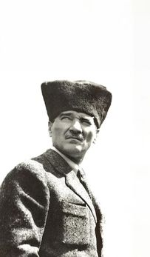
Reasons for the Failure of the Movement
The Khilafat Movement began to decline due to several political developments. The Non‑Cooperation Movement was suspended after the Chauri Chaura incident in 1922, which weakened the overall protest movement. More importantly, in 1924 Mustafa Kemal Atatürk abolished the Caliphate in Turkey itself. Since the institution the movement aimed to protect no longer existed, the Khilafat Movement gradually came to an end.

